Slide 1
Project on Car Price Prediction
Group 04:
Clement Justus S
Mohan Kumar R
Mohammed Saqlain
Prajwal Borse
Guided By:
Mrs. Smita

Slide 2
Aim of the Project
The aim is to use machine learning algorithms to develop models for predicting car prices. The focus of this project is developing machine learning models that can accurately predict the price of a car based on its features, in order to make informed purchases.
Implement and evaluate various learning methods on a dataset consisting of the sale prices of different makes and models across cities.
It is required to apply some data science techniques for the price of cars with the available independent variables that should help the management to understand how exactly the prices vary with the independent variables. They can accordingly manipulate the design of the cars, the business strategy etc. to meet certain price levels

Slide 3
Objectives And Motivation
To develop a efficient and effective model which predicts the price of a car according to user’s inputs.
To achieve good accuracy about the used car details, it's features and pricing.
To develop a User Interface( UI ) which is user-friendly and takes input from the user and predicts the price.
To predict a car price based on Several factors like: 'symboling', 'CarName', 'fueltype', 'aspiration', 'doornumber', 'carbody', 'drivewheel', 'enginelocation', 'wheelbase', 'carlength', 'carwidth', 'carheight', 'curbweight', 'enginetype', 'cylindernumber', 'enginesize', 'fuelsystem', 'boreratio', 'stroke', 'compressionratio', 'horsepower', 'peakrpm', 'citympg', 'highwaympg', 'price' , etc. can influence the actual worth of a car.

Slide 4
Background of the Project
The main concept behind this car price prediction, in which each car price is predicted based on 'Symboling', 'Car Name', 'fuel type', 'aspiration', 'door number', 'car body', 'drive wheel', 'engine location', 'wheelbase', 'car length', 'car width', 'car height', 'curb weight', 'engine type', 'cylinder number', 'engine size', 'fuel system', 'bore ratio', 'stroke', 'compression ratio', 'horse power', 'peak rpm', 'city mpg', 'highway mpg', 'price' based on all these categories the cars are been predicted.
modelling the price of cars with the available independent variables Which will be used by the management to understand how exactly the prices vary with the independent variables. They can accordingly manipulate the design of the cars, the business strategy etc. to meet certain price levels. Further, the model will be a good way for management to understand the pricing dynamics of a new market. Using so many other technologies in project we can predict the particular car can be sold for this particular price.

Slide 5
Introduction
Determining the listed price of a car is a challenging task, due to the many factors that drive a vehicle’s price on the market. The focus of this project is developing machine learning models that can accurately predict the price of a car based on its features, in order to make informed purchases.
Implement and evaluate various learning methods on a dataset consisting of the sale prices of different makes and models .compare the performance of various machine learning algorithms like linear Regression, Random forest Regression, Decision tree Regression and choose the best out of it.
Depending on various parameters can predict the price of the car. Regression Algorithms are used because they provide us with continuous value as an output and not a categorized value because of which it will be possible to predict the actual price a car rather than the price range of a car. User Interface has also been developed which acquires input from any user and displays the Price of a car according to user’s inputs.

Slide 6
Problem Statement
A Chinese automobile company Geely Auto aspires to enter the US market by setting up their manufacturing unit there and producing cars locally to give competition to their US and European counterparts.
They have contracted an automobile consulting company to understand the factors on which the pricing of cars depends.
Specifically, they want to understand the factors affecting the pricing of cars in the American market, since those may be very different from the Chinese market.
The company wants to know: Which variables are significant in predicting the price of a car How well those variables describe the price of a car Based on various market surveys, the consulting firm has gathered a large data set of different types of cars across the America market.

Slide 7
Solution/Proposed System
The process starts by collecting the dataset. The next step is to do Data Pre processing which includes Data cleaning, Data reduction, Data Tranformation.
Then, using various machine learning algorithms we will predict the price. The algorithms involve Linear Regression, Random forest Regression and Decision Tree Regression.
The best model which predicts the most accurate price is selected.
After selection of the best model the predicted price is displayed to the user according to user’s inputs. User can give input through website to for used car price prediction to machine learning model.

Slide 8
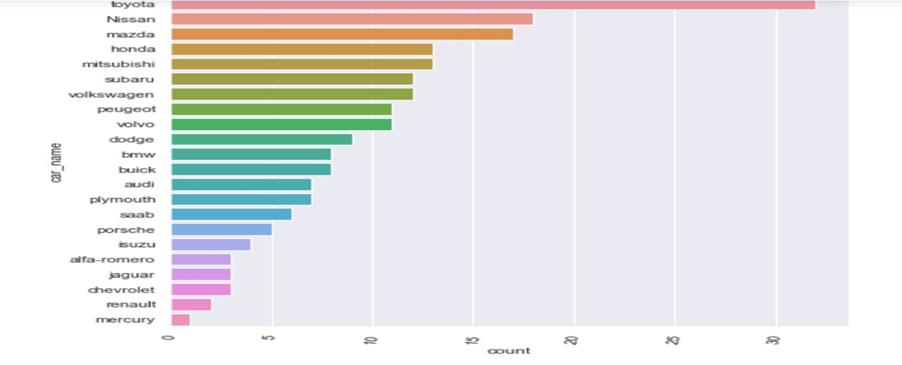
Data Visualization
Data visualization provides a good, organized pictorial representation of the data which makes it easier to understand, observe, analyze. You can gain key insights into your data through different graphical representations.

Slide 9
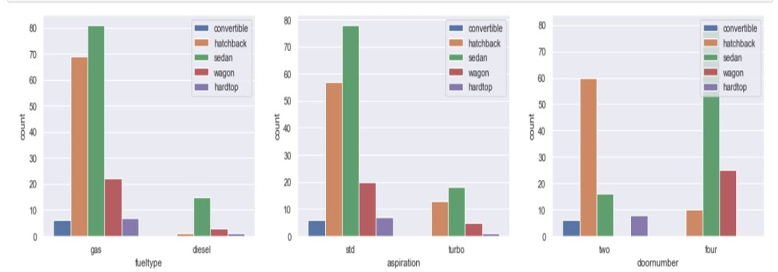

Seaborn helps you explore and understand your data. Its plotting functions operate on dataframes and arrays containing whole datasets and internally perform the necessary semantic mapping and statistical aggregation to produce informative plots. Its dataset-oriented, declarative API lets you focus on what the different elements of your plots mean, rather than on the details of how to draw them

Slide 10
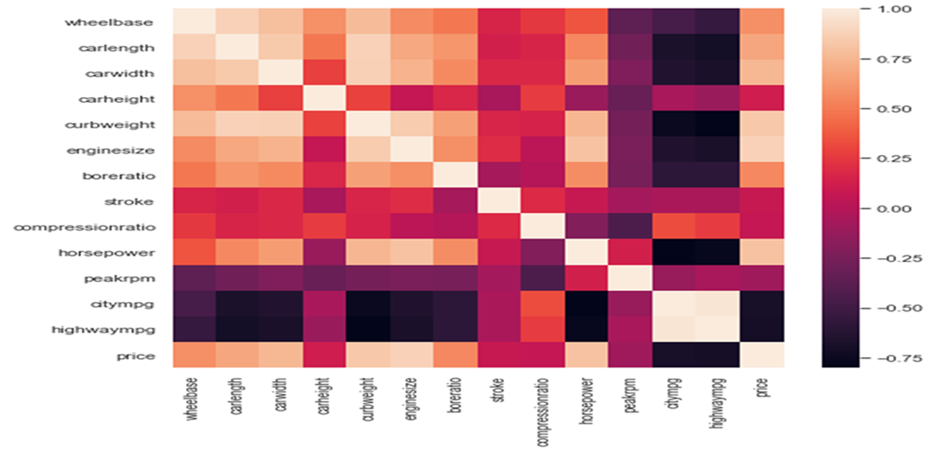
Heat map
Heatmap is defined as a graphical representation of data using colors to visualize the value of the matrix. Heatmap is also defined by the name of the shading matrix. Heatmaps in Seaborn can be plotted by using the seaborn.heatmap() function.
wheelbase has high positive correlation with carlength,carwidth and curbweight
carlength has high postive correlation with curbweight
carlength has negative correlation with highwaympg
carwidth has high postive correlation with curbweight and engine size
enginesize has high positive correlation with horsepower
curbweight has high positive correlation with engine size and horse power, negative correlation with highwaympg
horsepower has negative correlation with citympg and highwaympg
citympg and highwaympg are highly correlated.

Slide 11
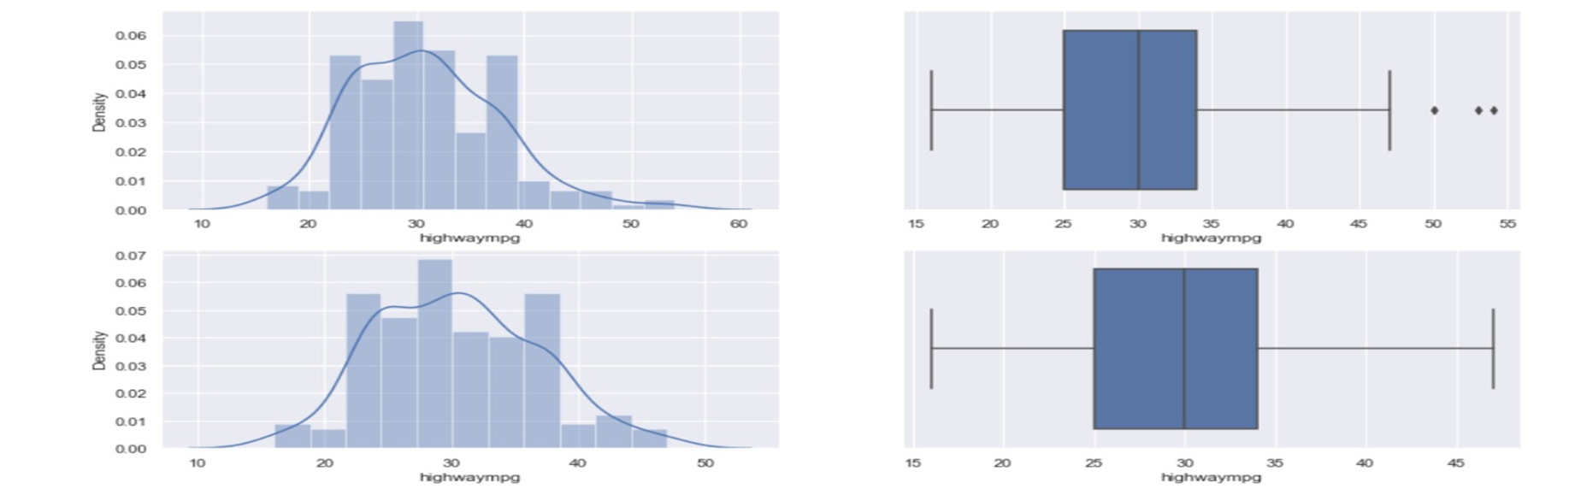
Data Pre processing
Data Pre processing is a technique that is used to convert the raw data into a clean data set. In other words, whenever the data is gathered from different sources it is collected in raw format which is not feasible for the analysis.
Data pre processing is the first machine learning step in which we transform raw data obtained from various sources into a usable format to implement accurate machine learning models. In this article, we cover all the steps involved in the data pre processing phase.

Slide 12
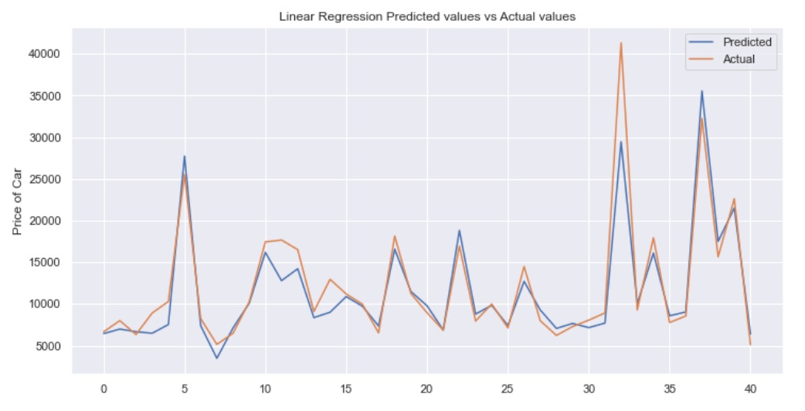
Linear Regression :
Linear Regression attempt to model the relationship between two variables by fitting a linear equation to observed data. The other is considered to be dependent variable.
Linear regression is useful for finding relationship between multiple continuous variables There are multiple independent variables and single independent variable.
By Evaluating Linear Regression between Predicted value and Actual values ,The accuracy obtained is 70%

Slide 13
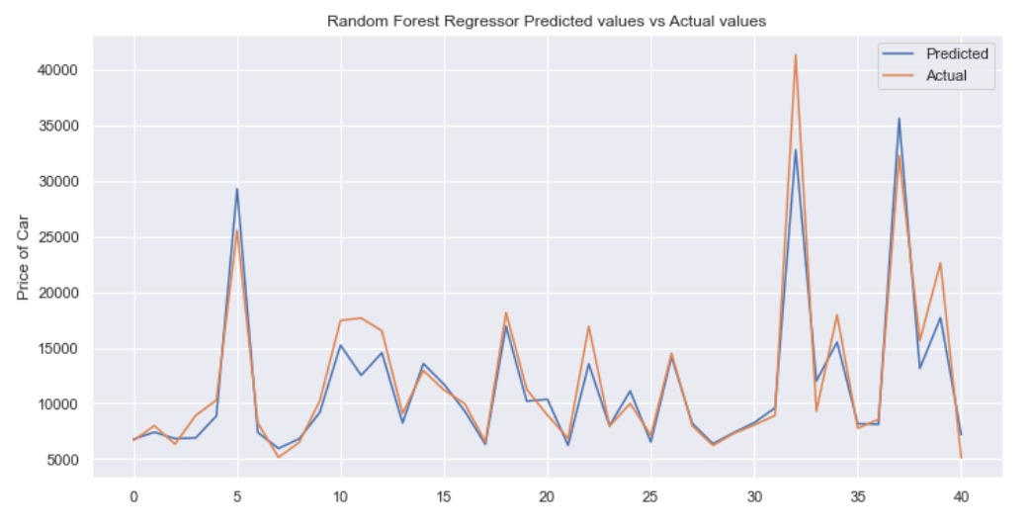
Random forest Regression:
A random forest is a meta estimator that fits a number of classifying decision trees on various sub-samples of the dataset and uses averaging to improve the predictive accuracy and control over-fitting. Random Forest Regression is a supervised learning algorithm that uses ensemble learning method for regression.
By Evaluating Random Forest Regression between Predicted value and Actual values ,
The accuracy obtained is 90%

Slide 14
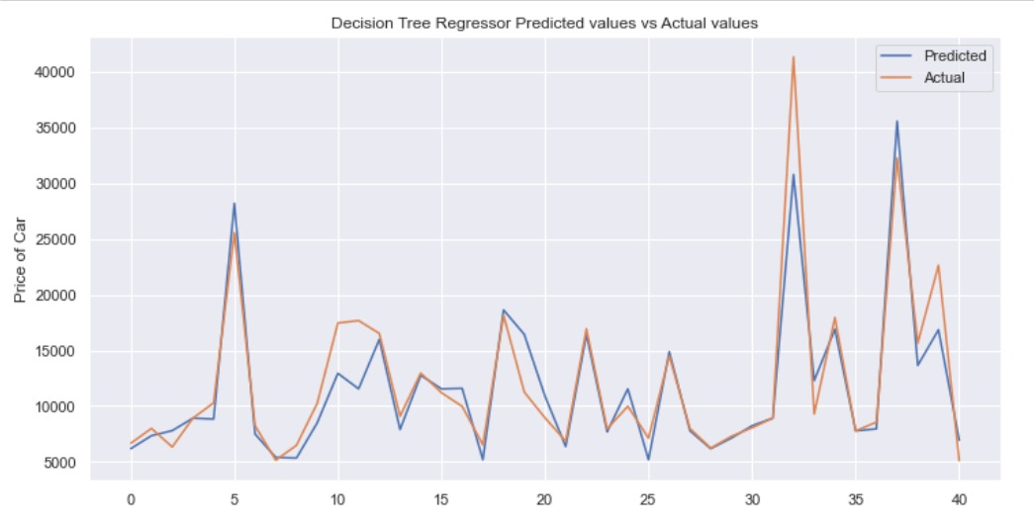
Decision Tree
Decision Tree is a decision-making tool that uses a flowchart-like tree structure or is a model of decisions and all of their
possible results, including outcomes, input costs, and utility.
Decision-tree algorithm falls under the category of supervised learning algorithms. It works for both continuous as well as categorical output
variables.
By Evaluating Decision Tree Regression between Predicted value and Actual values ,The accuracy obtained is 88%

Slide 15
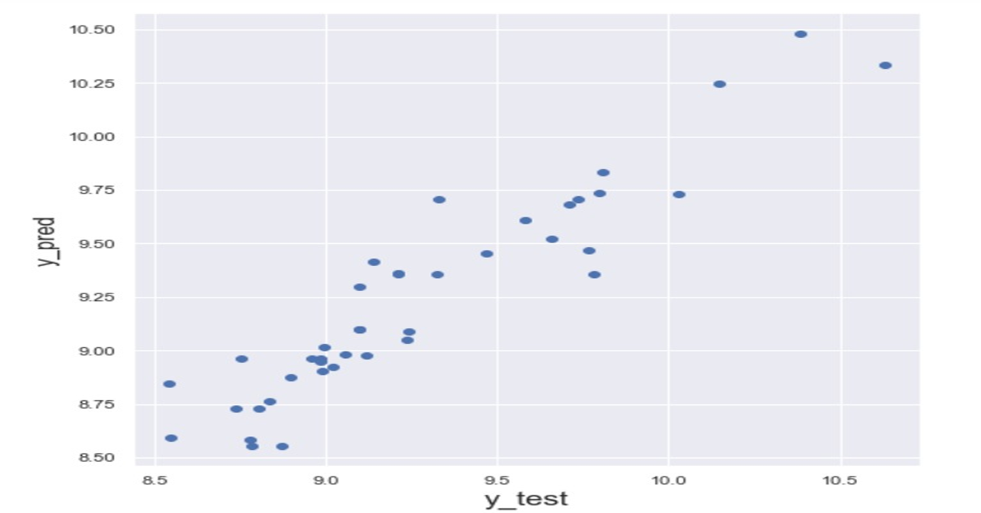
Evaluation of Model
Model evaluation is the process of using different evaluation metrics to understand a machine learning model's performance, as well as its strengths and weaknesses. Model evaluation is important to assess the efficacy of a model during initial research phases, and it also plays a role in model monitoring.

Slide 16
Upgrades
Model Evaluation is an integral part of the model development process. It helps to find the best model that represents our data and how well the chosen model will work in the future.
Evaluating model performance with the data used for training is not acceptable in data science because it can easily generate over optimistic and overfitted models. There are two methods of evaluating models in data science, Hold-Out and Cross-Validation. To avoid overfitting, both methods use a test set (not seen by the model) to evaluate model performance. Working on the the machine learning models received an 90% accuracy on the training dataset and approx.80% accuracy on the test data. The model looks really quite well trained and can be used for prediction of car prices based on various parameters.

Slide 17
Conclusion
Working on all three models Linear Regression, Decision Tree Regressor, and Random Forest Regressor
the accuracy obtained for each model is
Linear Regression: 0.73
Decision Tree: 0.88
Random forest: 0.90
Among these 3 Regressions Random forest performing best (with accuracy ~ 0.90)

Slide 18
Thank you.

